Slide 1
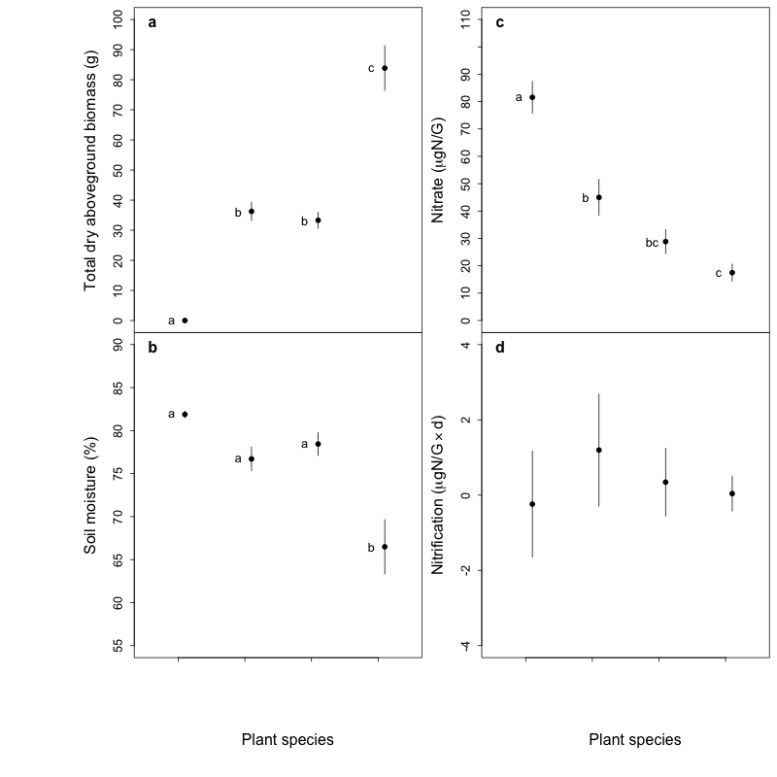
Unplanted
Panicum
Sorghum
Unplanted
Panicum
Sorghum
Microstegium
Microstegium

Slide 2
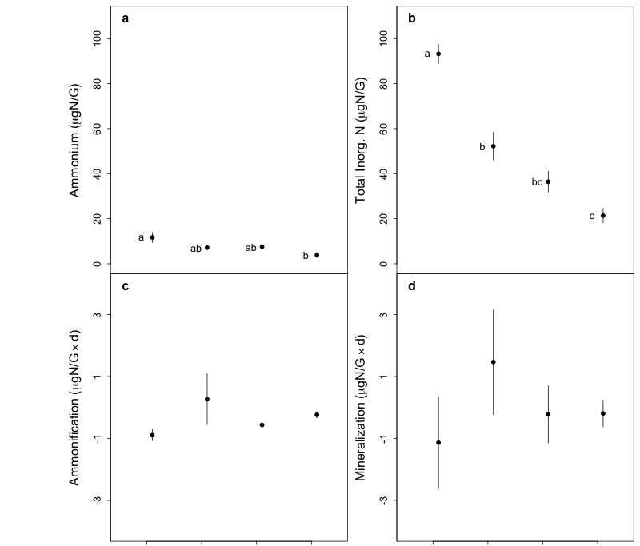
Unplanted
Panicum
Sorghum
Unplanted
Panicum
Sorghum
Microstegium
Microstegium

Slide 3
